Slide 1
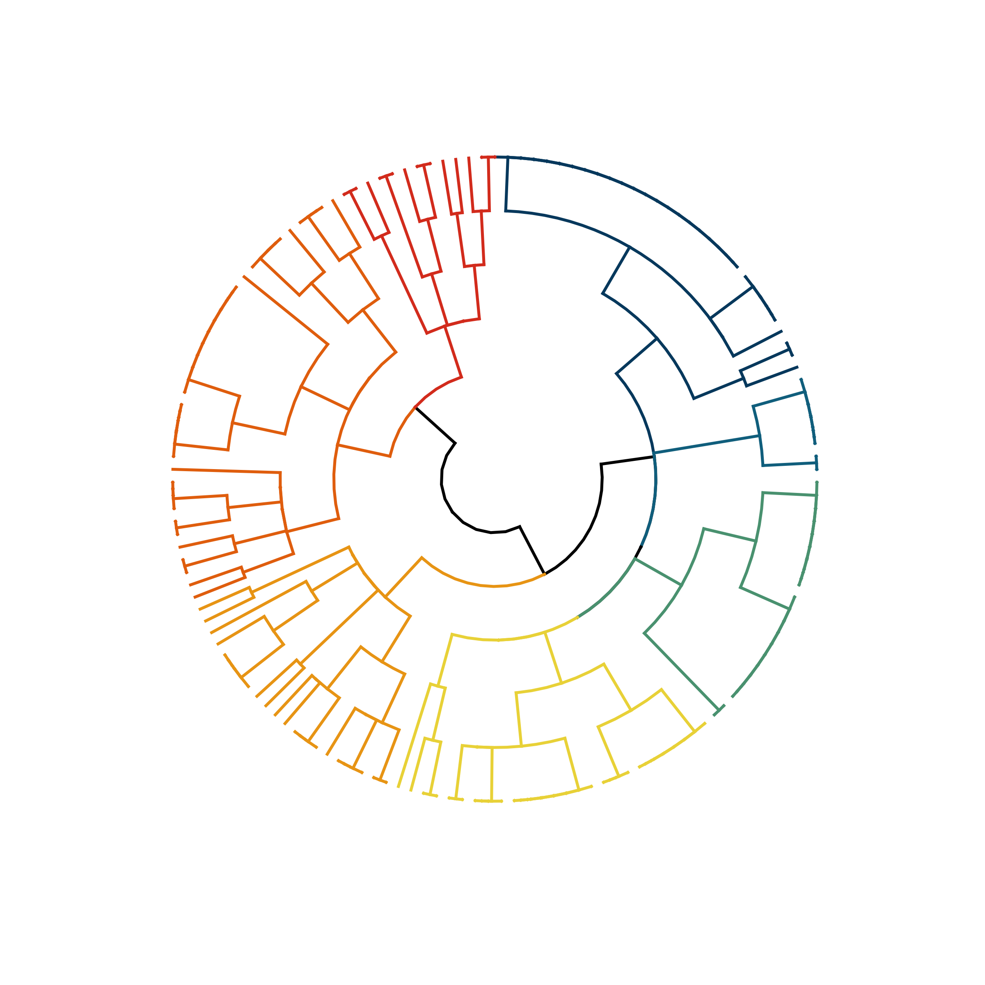
1. Adult, offshore, mesopelagic, seasonal & diel migrant spp. (31)
2. Mixed age, offshore mesopelagic, non-seasonal & diel migrant spp. (36)
3. Mixed age, continental shelf, seasonal & diel migrant spp. (24)
4. Juvenile, coast & shelf seasonal & non-diel migrant spp. (21)
5. Juvenile offshore, mesopelagic, seasonal & diel migrant spp. (8)
7. Mixed coastal & shelf, non-seasonal & non-diel migrant spp. (13)
6. Juvenile offshore to coastal, epipelagic, seasonal & diel migrant spp. (21)
7
1
2
5
6
4
3
Notes:
USE!!! PROBABLE TRAITS, k = 8, DIVISIVE

Slide 2
1. Adult, offshore, mesopelagic, seasonal & diel spp.
2. Mixed, offshore mesopelagic, non-seasonal & diel spp.
3. Mixed, continental shelf, seasonal & diel migrant spp.
4. Juvenile, coast & shelf seasonal & non-diel spp.
5. Juvenile offshore, mesopelagic, seasonal & diel spp.
7. Mixed coastal & shelf, non-seasonal & non-diel spp.
6. Juvenile offshore to coastal, epipelagic, seasonal & diel spp.
1
Juvenile offshore, mesopelagic, seasonal & diel spp.
2
7
1
3
Juvenile offshore to coastal, epipelagic, seasonal & diel spp.
2
5
4
6
4
5
Juvenile, coast & shelf seasonal & non-diel spp.
3
6
7
Notes:
USE!!! PROBABLE TRAITS, k = 8, DIVISIVE

Slide 3
Mixed coastal & shelf, non-seasonal & non-diel spp.
Adult offshore, mesopelagic, seasonal & diel spp.
Mixed, offshore mesopelagic, non-seasonal & diel spp.
7
1
Juvenile offshore, mesopelagic, seasonal & diel spp.
2
5
6
4
Juvenile offshore to coastal, epipelagic, seasonal & diel spp.
3
Juvenile, coast & shelf seasonal & non-diel spp.
Mixed, continental shelf, seasonal & diel migrant spp.
Notes:
USE!!! PROBABLE TRAITS, k = 8, DIVISIVE

Slide 4
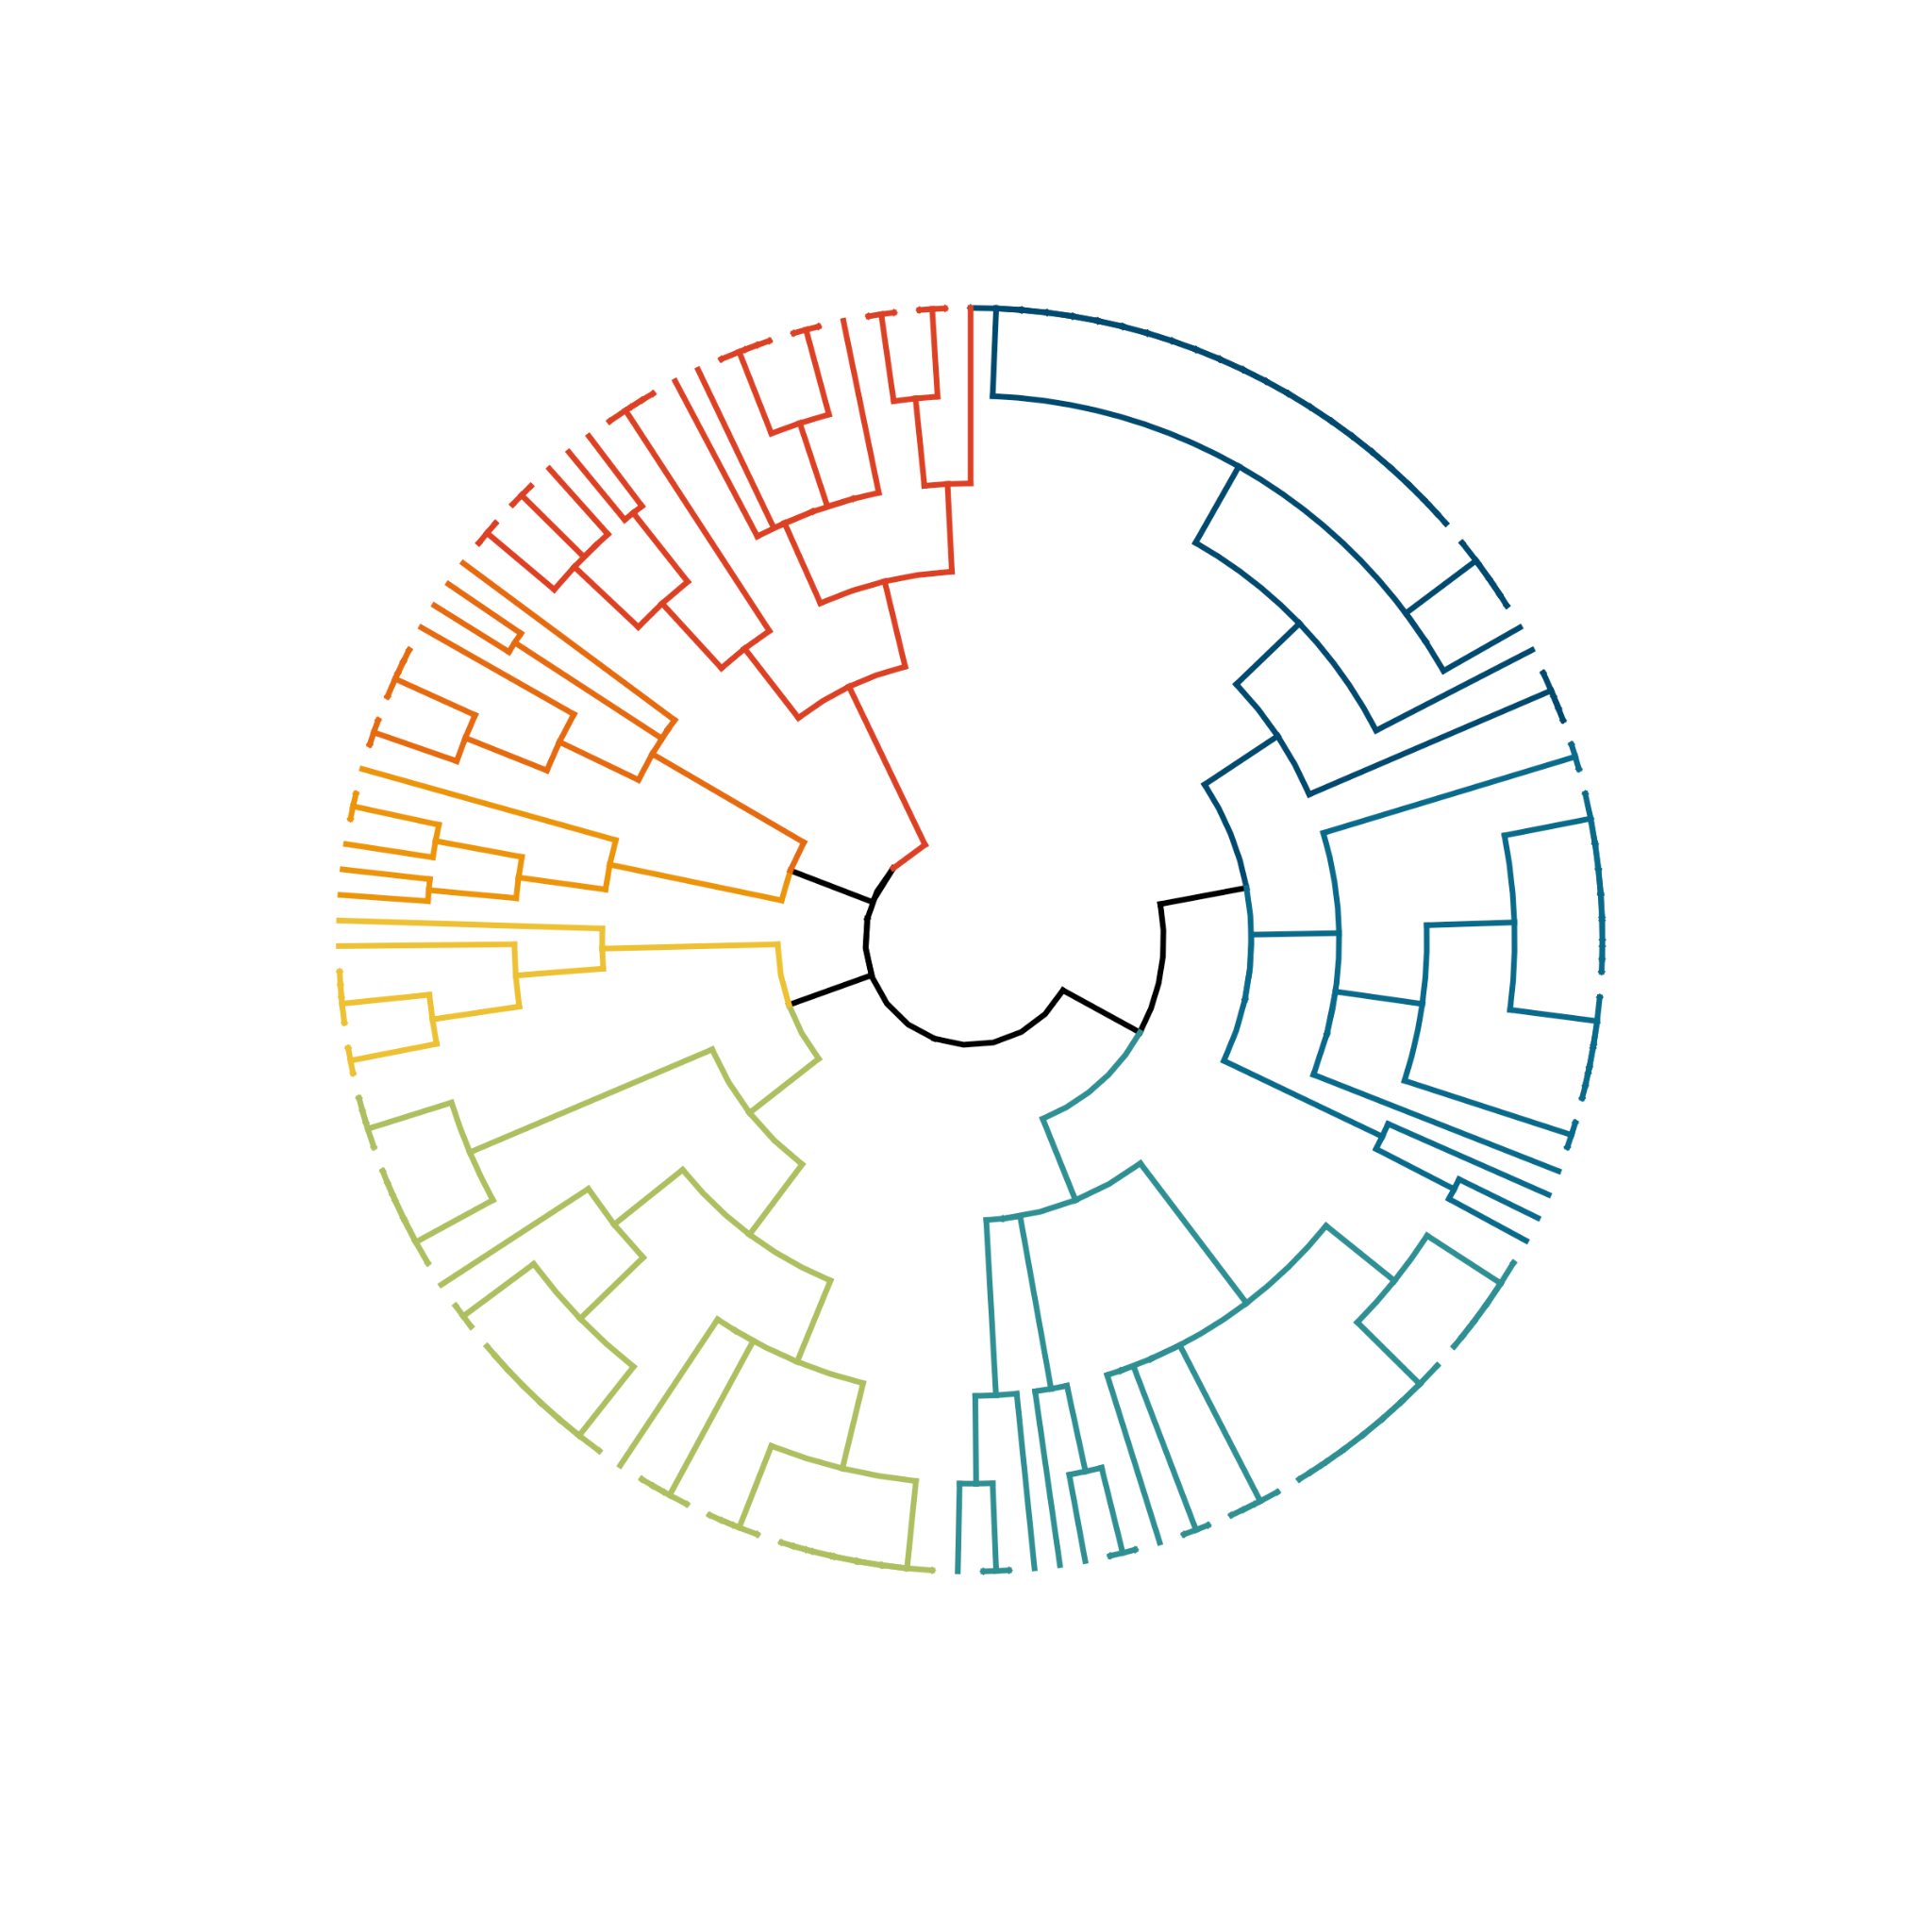
Juvenile, seasonal shelf & coastal spp.
Adult, seasonal, diel migrant, mesopelagic spp.
Adult, seasonal & shelf spp.
8
6
1
Adult, solitary, resident & benthic spp.
Juvenile, oceanic, pelagic, seasonal & diel migrant spp.
2
4
7
Juvenile, seasonal & coastal epipelagic spp.
3
5
Shelf & coastal, seasonal, diel migrant spp.
Oceanic, mesopelagic, diel migrant spp.
Notes:
USE!!! PROBABLE TRAITS, k = 8, DIVISIVE

Slide 5
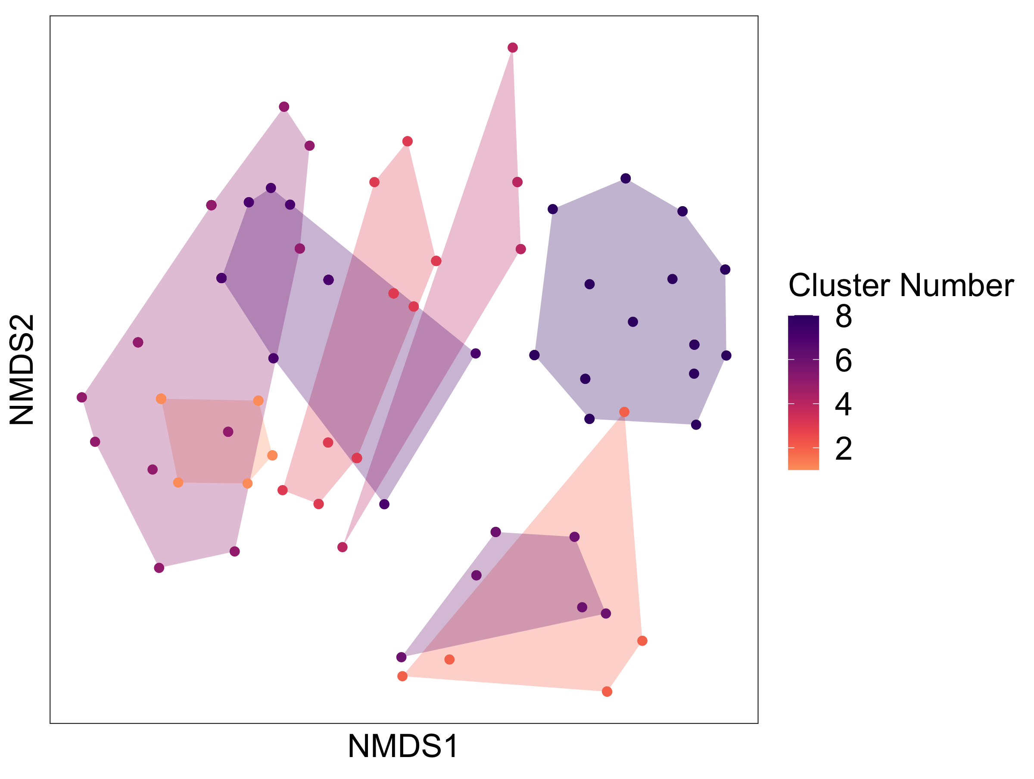
a)
b)
Notes:
USE!!! PROBABLE TRAITS, k = 8, DIVISIVE with NMDS PLOT

Slide 6
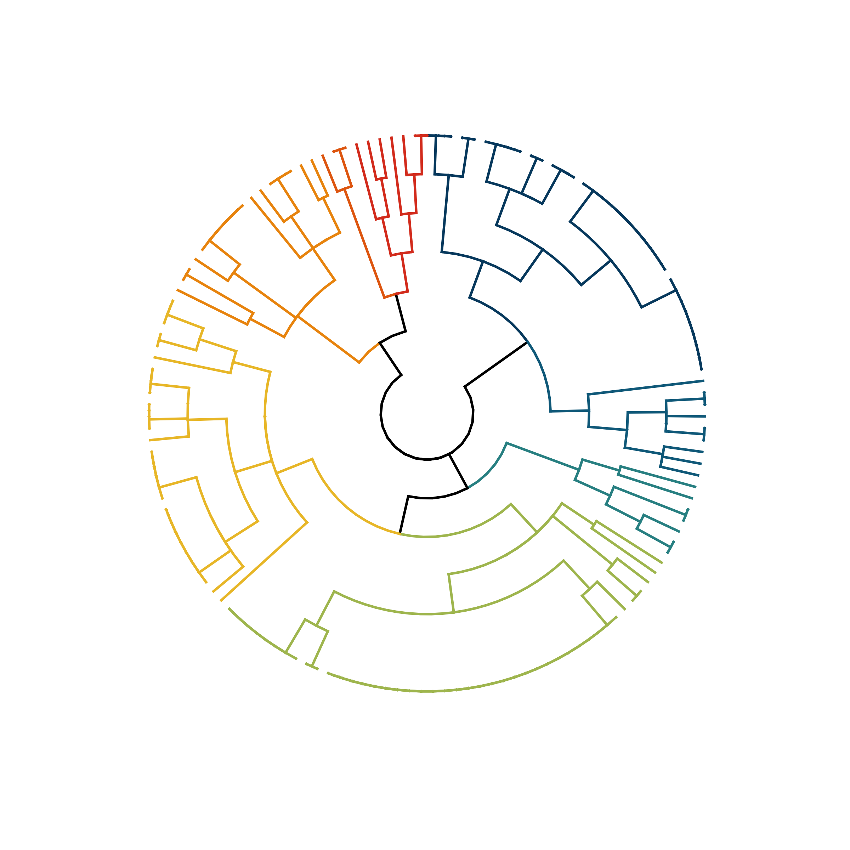
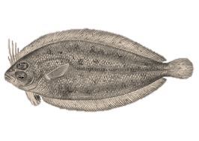
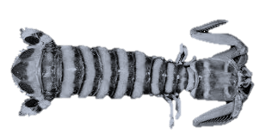
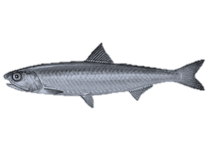
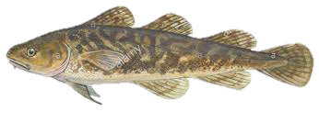
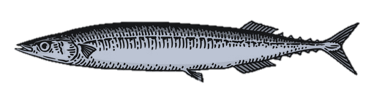
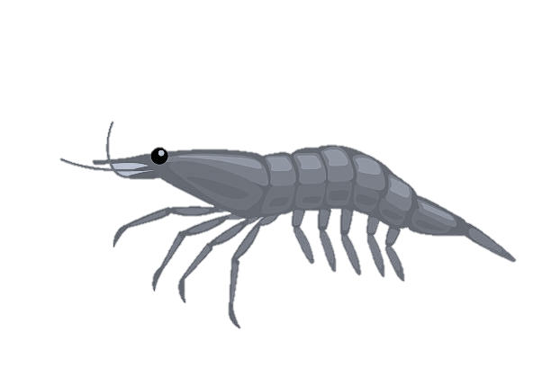
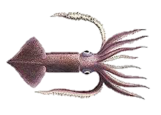
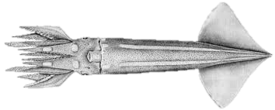
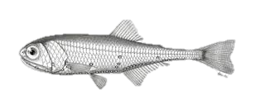
Benthic continental shelf diel migrants
Solitary, benthic reef residents
8
Schooling migratory, offshore and coastal epipelagics
Schooling, seasonal continental shelf demersal
2
4
6
5
Schooling coastal to shelf epipelagics
Schooling continental shelf diel migrants
3
7
1
Solitary shelf & offshore epipelagics
Schooling, diel migrant offshore mesopelagics
Notes:
PROBABLE TRAITS, k = 8, old version

Slide 7
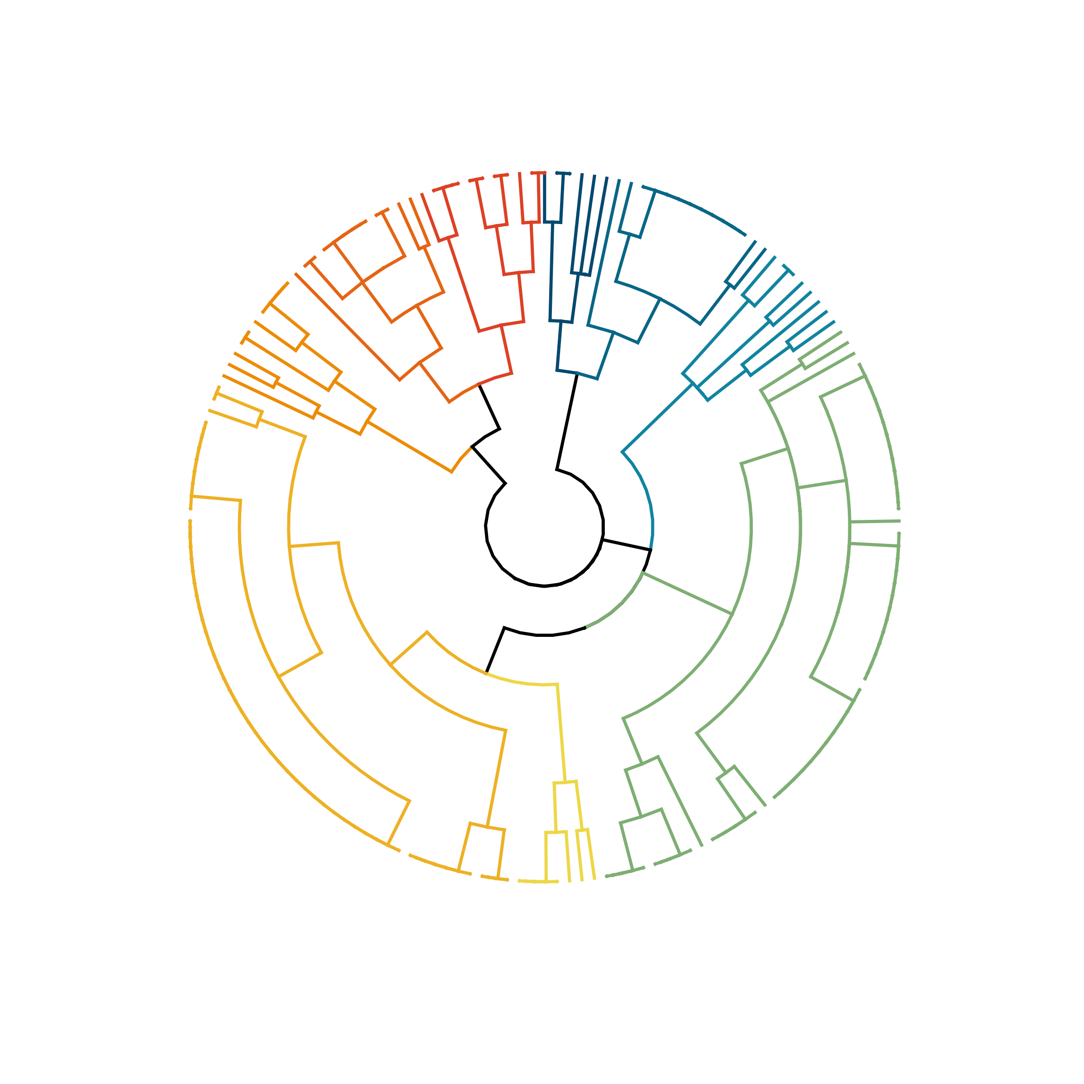
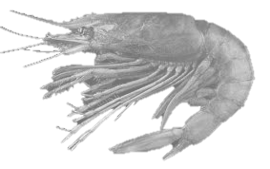
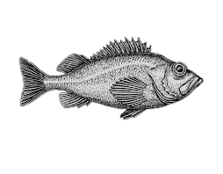
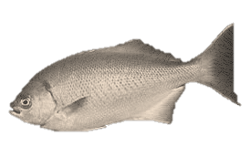
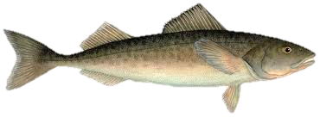
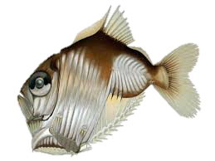
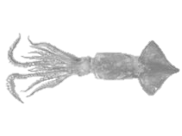
Albacore prey cluster dendrogram – adult habitat use + gregarious (binary) traits – agglomerative (average k = 9) Jul 2020
Solitary, benthic reef to shelf residents
Schooling continental slope, diel & seasonal migrants
Schooling, demersal reef to shelf demersal residents
Schooling shelf & coast, diel migrant & demersal
Solitary shelf & offshore non-migratory epipelagics
9
4
5
Solitary & seasonal, diel migrant, benthic reef to shelf
8
6
3
1
2
Schooling, migratory and seasonal shelf to offshore epipelagics
Schooling offshore mesopelagic diel migrants
7
Schooling shelf epi-mesopelagic, diel migrants
Notes:
ADULT TRAITS, k = 9, old version

